Slide 1

Forecasting Air Pollution
Group 2:
1. Chandra Mouli
2. Sai Prasad
3. R Ramanandh
4. Swapna Rani
5. K Shilpa
Mentor Name: MunMun
Date: 30-01-2021

Slide 2
Business Problem:
Particulate matter (PM ) has been recorded in Delhi to understand the air quality on an hourly basis for 4 months. Our objective is to forecast the data available.
Objective:
The objective of the analysis is to forecast Particulate Matter (PM) in air for next 24 Hours based on the available data.

Slide 3
Project Architecture / Project Flow
Data Exploration
Dataset:
Rows: 2376
Columns: 3
Missing Values: 80
Missing Dates: 243
EDA and Visulization
Removed 1st Row as it is the description of dataset
Removed 3rd Column as it is not having any values.
Basic Line plot.
Seasonal Decompose.
Heat Maps.
Box – Whisker plots.
ACF and PACF Plots.
Data Preprocessing
Resampled data to fill missing dates, after resampling no. of rows are 2167.
Missing values are imputed with month wise hourly mean.
AD-Fuller Test to confirm stationarity of data.
Deployment
Model deployment done through Flask on Google Cloud Platform.
Model Performance
RMSE Values
1. Quadratic model with Additive seasonality: 73.56
2. Simple Exponential Model: 84.27
3. ARIMA: 83.45
4. SARIMA: 73.31
Model Building
Linear models
Smoothing models
ARIMA
SARIMA
Decided to go with SARIMA as the RMSE is least compared to other models.

Slide 4
Exploratory Data Analysis (EDA)

Slide 5
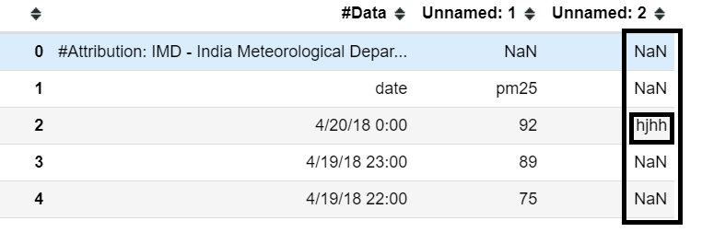
Data set details
Dataset:
No. of Rows = 2376
No. of Columns = 3
Column 1: Date – Contains dates from 01-01-2018 00:00:00 to 20-04-2018 00:00:00
Column 2: PM25 refers to atmospheric particulate matter (PM) that have a diameter of less than 2.5 micrometers, which is about 3% the diameter of a human hair and usually seen through a microscope.
Column 3: Unnamed - There is only one value in the column which is of no use.
Source :- IMD - India Meteorological Department http://www.imd.gov.in/

Slide 6
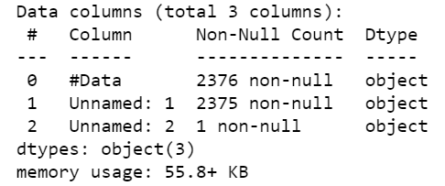
Exploratory Data Analysis (EDA)
Dataset info:
Removed the first row, as it describes the dataset and third column, as it contains only one value for the entire column.
Both the columns are in string format, hence changed the format of column 1(date) to Datetime format and column 2(pm25) to numeric(float) format.
There are 80 missing values in column 2(pm25), hence the same are imputed with mean.
Total Dates Missing = 243, hence resampled and imputed the missing values with hourly mean of the month where the values are missing.
After resampling the dataset is having 2617 rows.

Slide 7
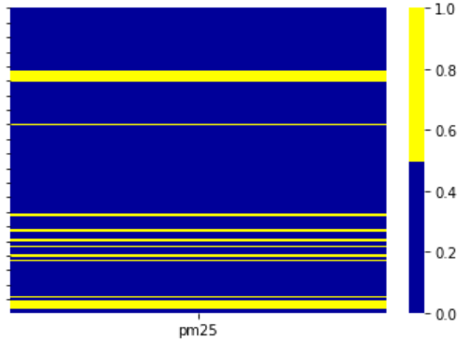
EDA Continued
Visualizing Null values with Heat Map.

Slide 8
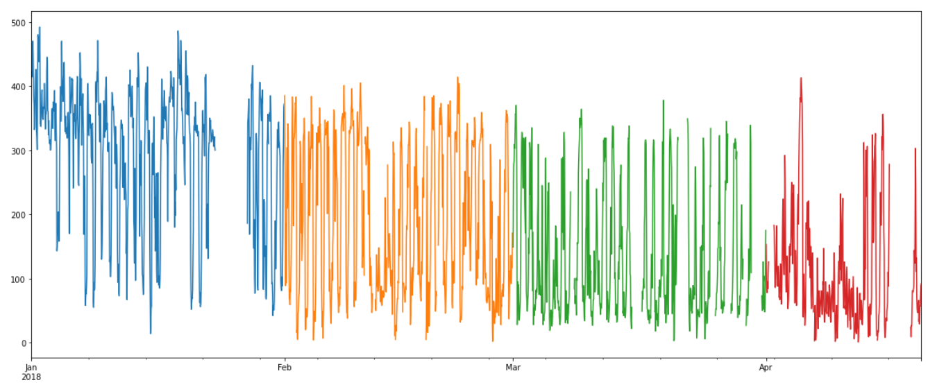
Visualizing the Dataset to identify the missing values.
Month Wise Missing Values
Month | Missing Values
Jan | 96
Feb | 20
Mar | 127
Apr | 80

Slide 9
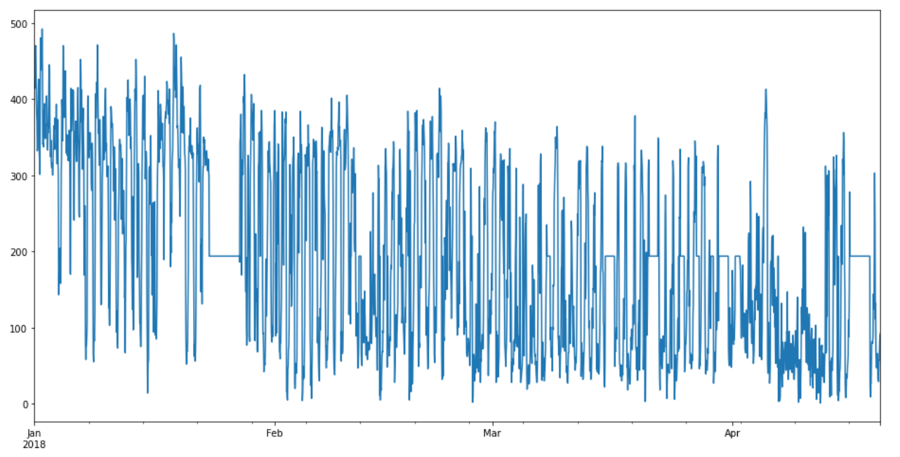
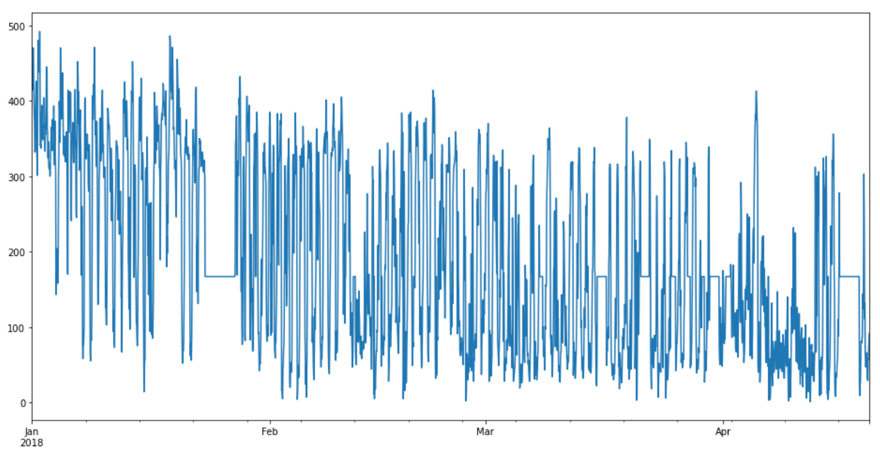
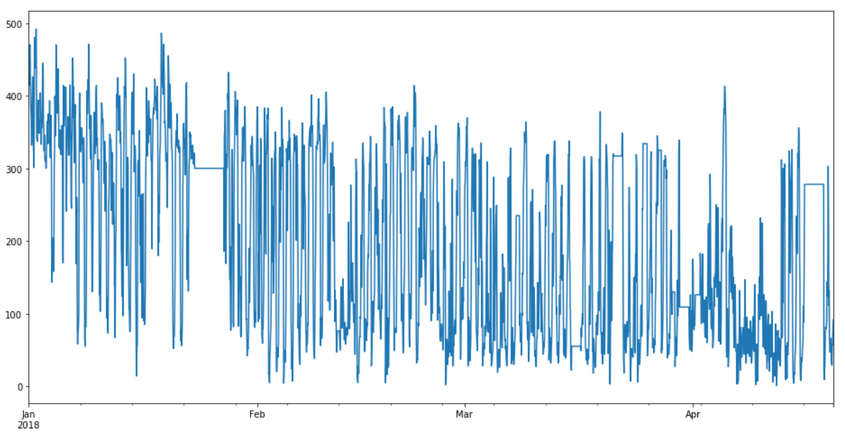
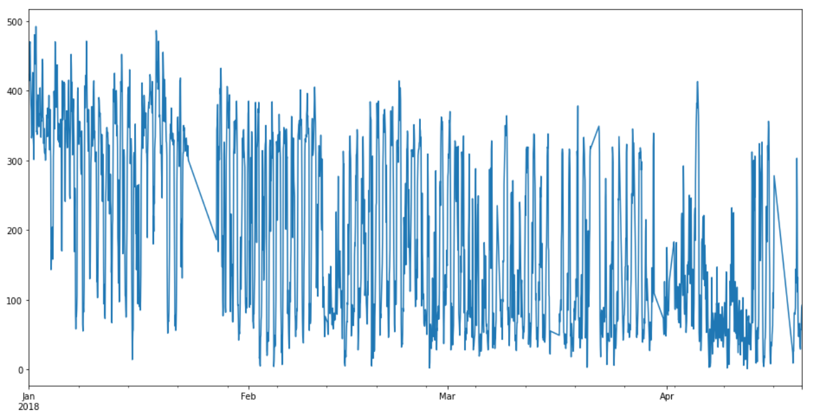
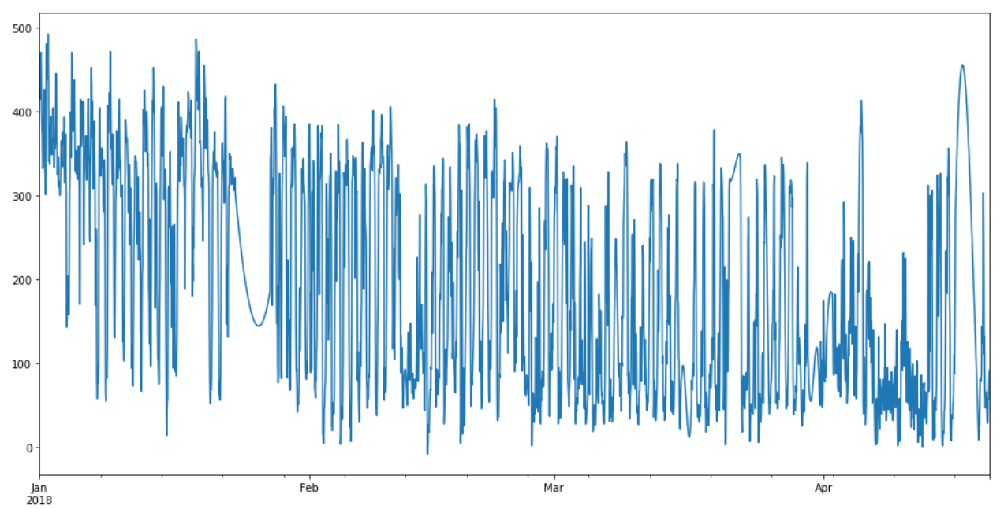
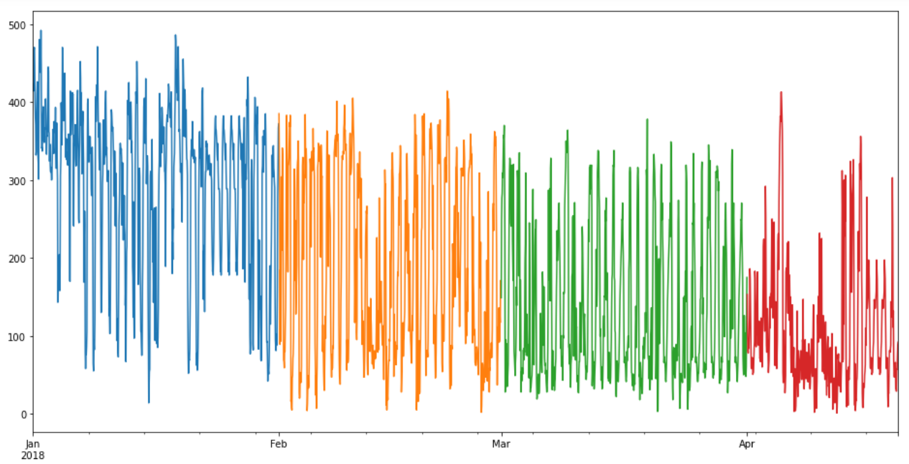
Imputation Methods Used
Mean Imputation
Median Imputation
Interpolation Method = ffill
Interpolation Method = time
Interpolation Method = akima
Month and day wise hourly mean

Slide 10
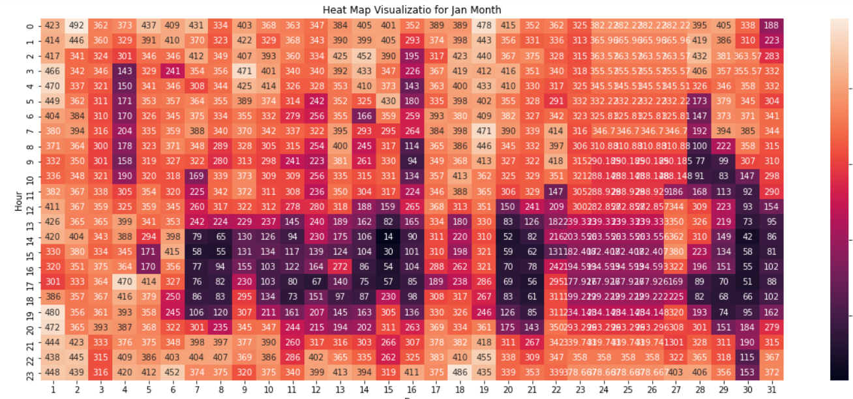
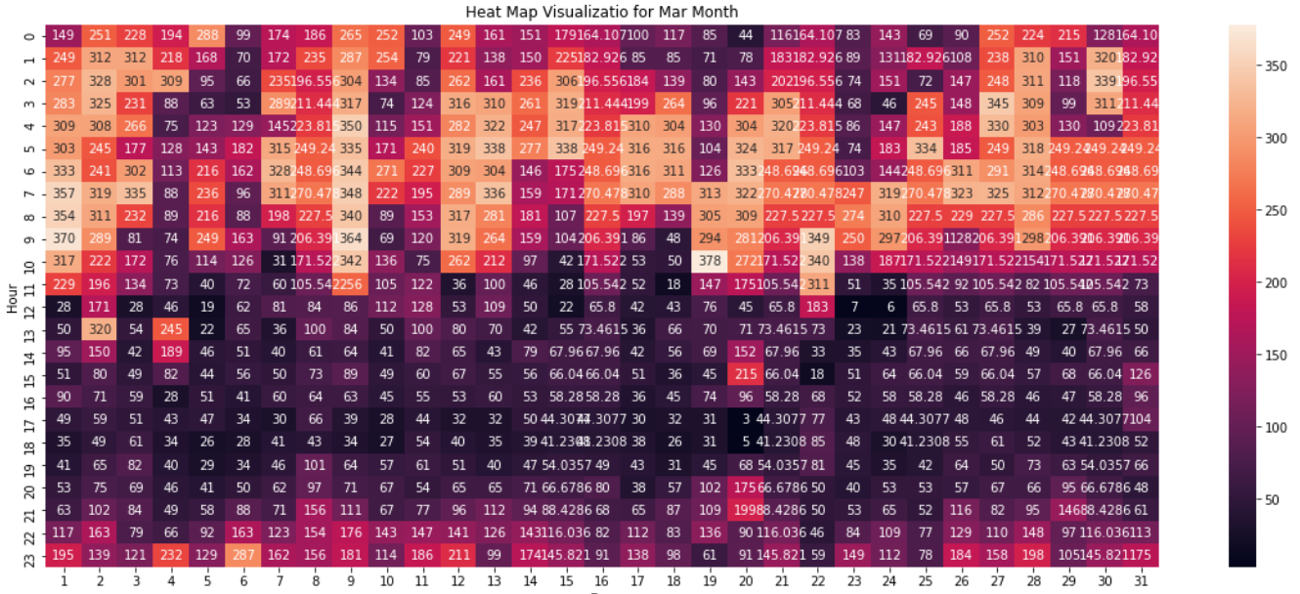
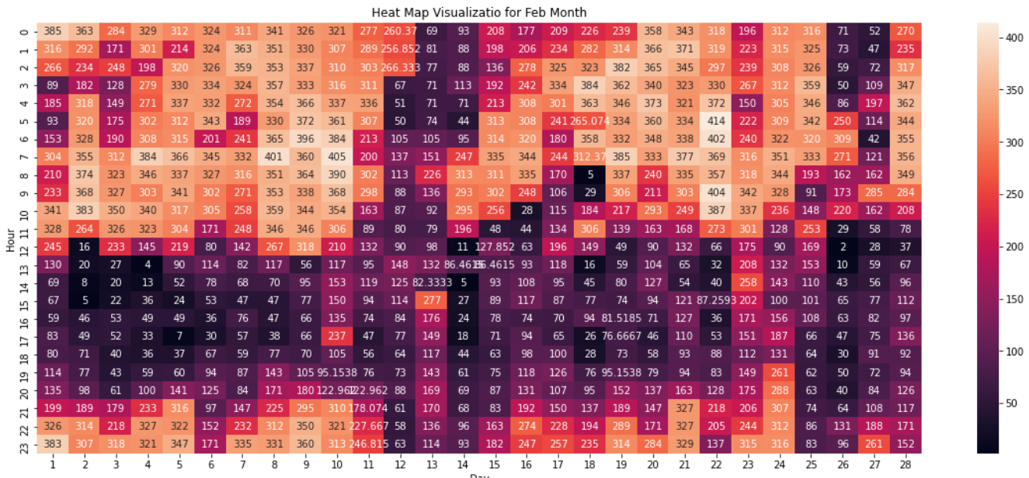
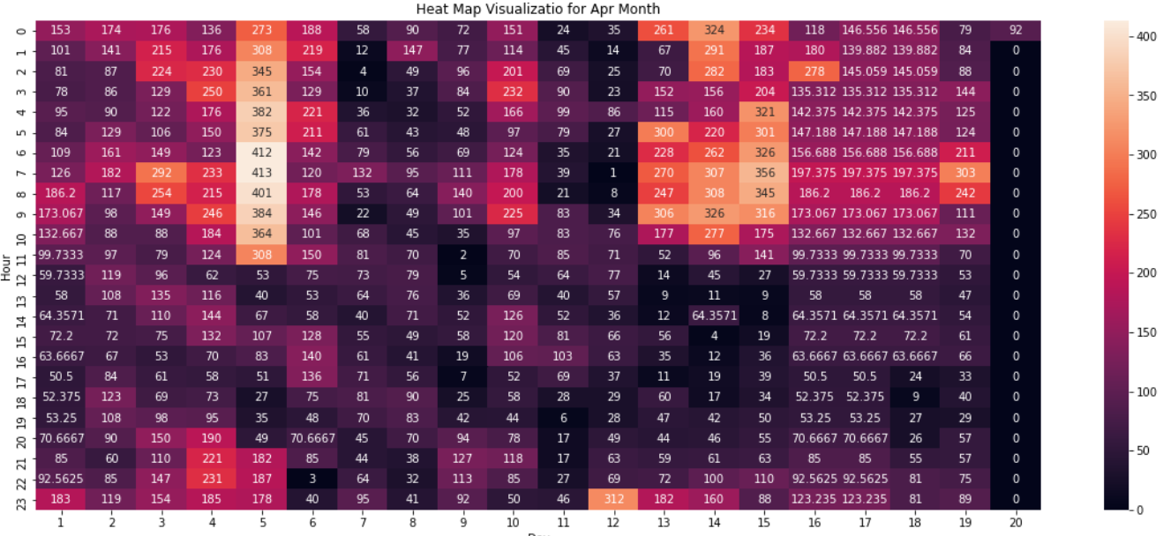
EDA Continued
Heat Map Visualization of Monthly Day wise / Hourly, level of Particulate matter in air
January - 2018
March- 2018
February - 2018
April - 2018

Slide 11
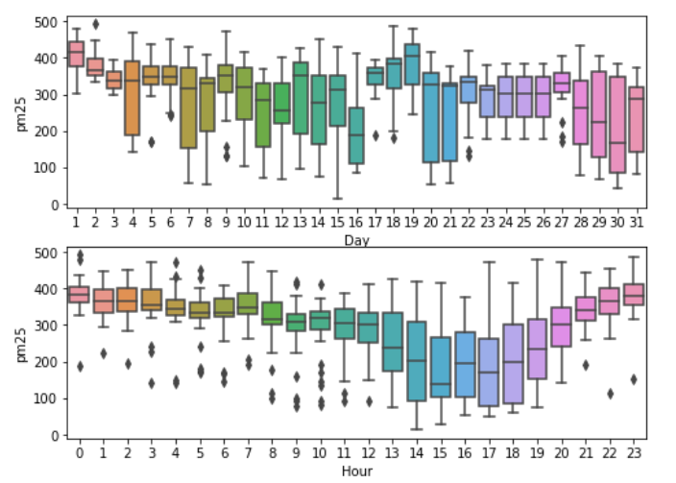
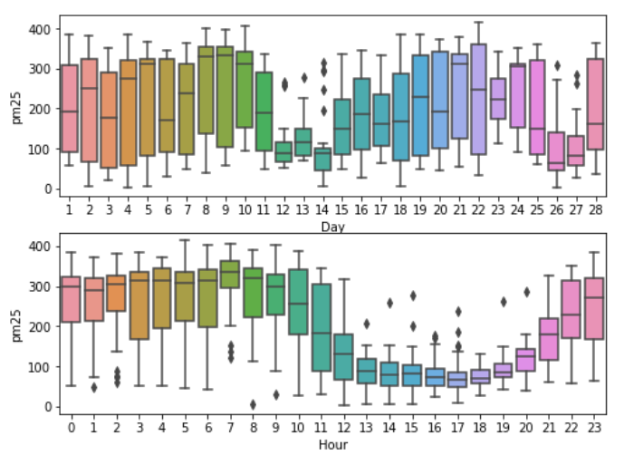
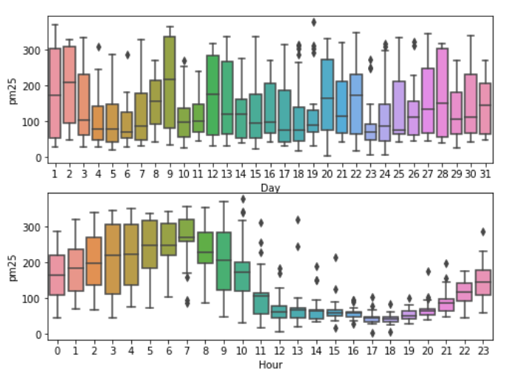
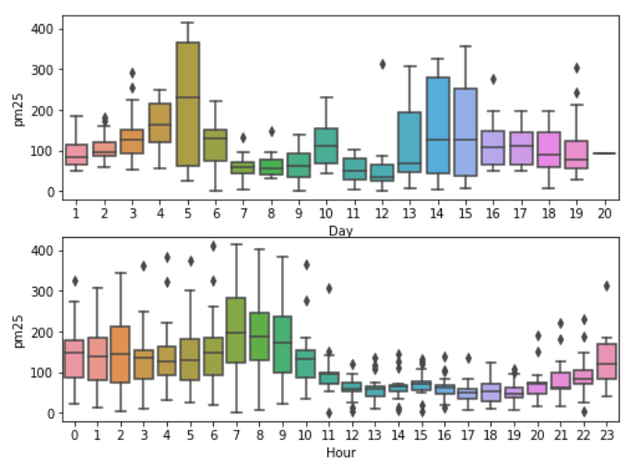
EDA Continued
Boxplot Visualization of Monthly Day wise / Hourly, level of Particulate matter in air
January - 2018
March- 2018
February - 2018
April - 2018

Slide 12
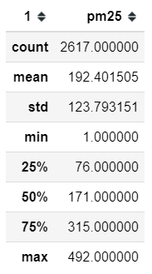
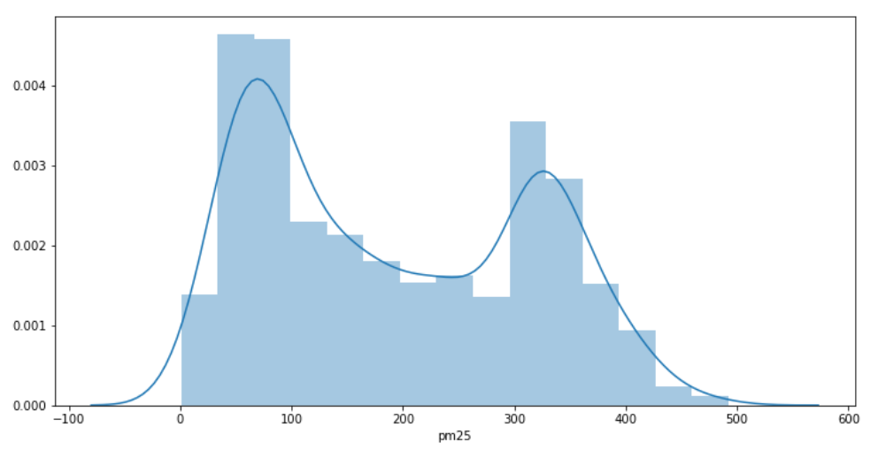
EDA Continued
Descriptive Statistics
Distribution plot (pm25)

Slide 13
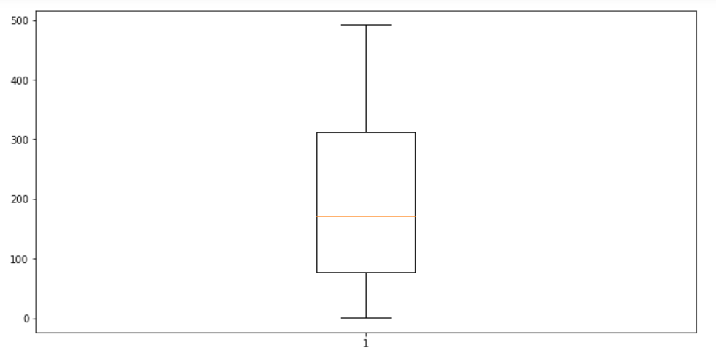
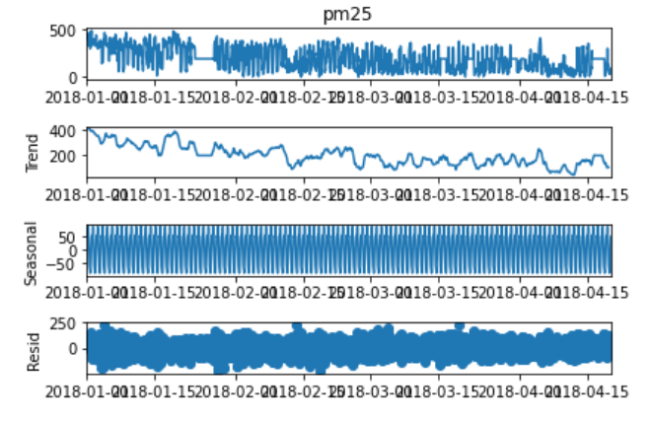
EDA Continued
Boxplot to identify outliers in the data (pm25).
Seasonal decompose to identify Trend, Seasonality and Residuals.

Slide 14
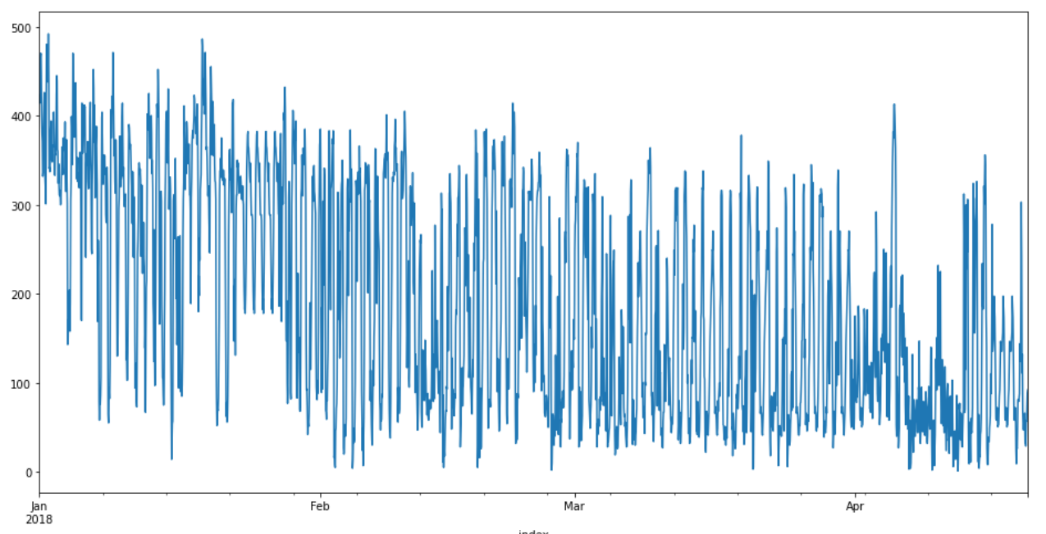
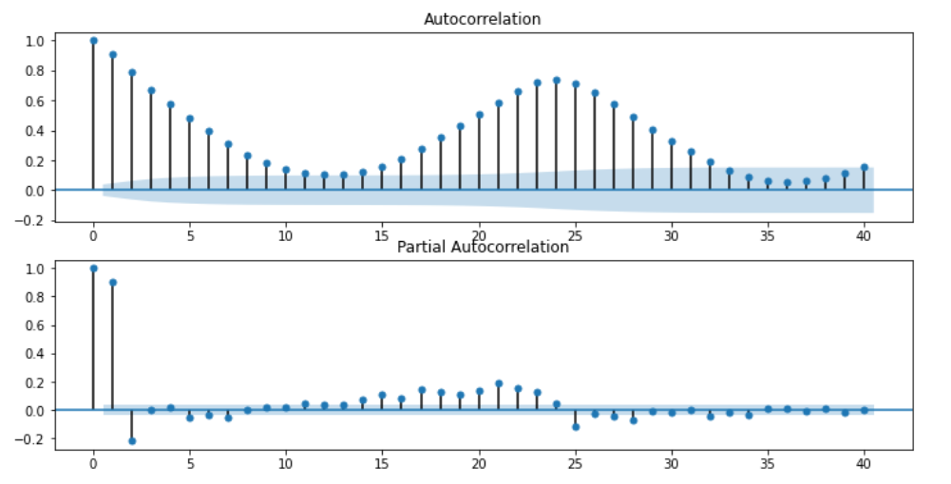
Basic line plot on original data.
ACF and PACF on original data.

Slide 15
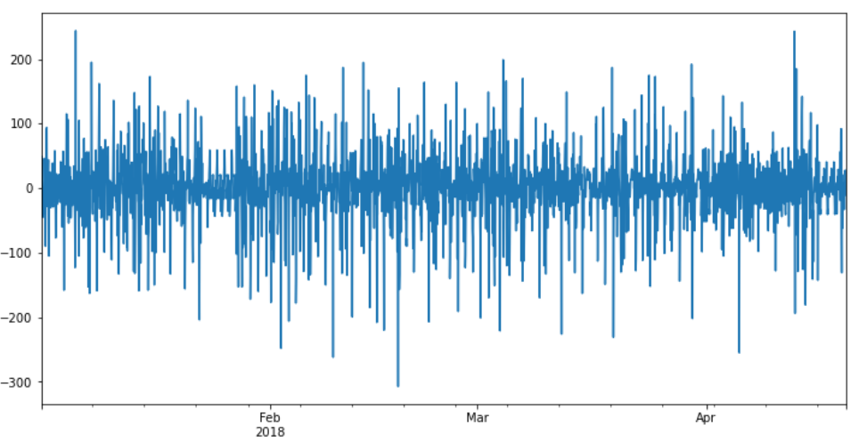
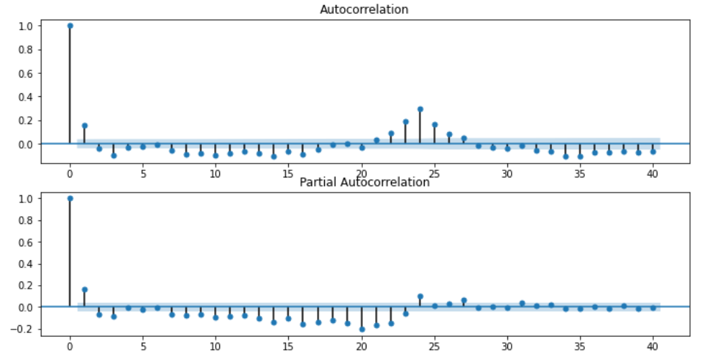
Basic line plot on differenced data.
ACF and PACF plots on differenced data.

Slide 16
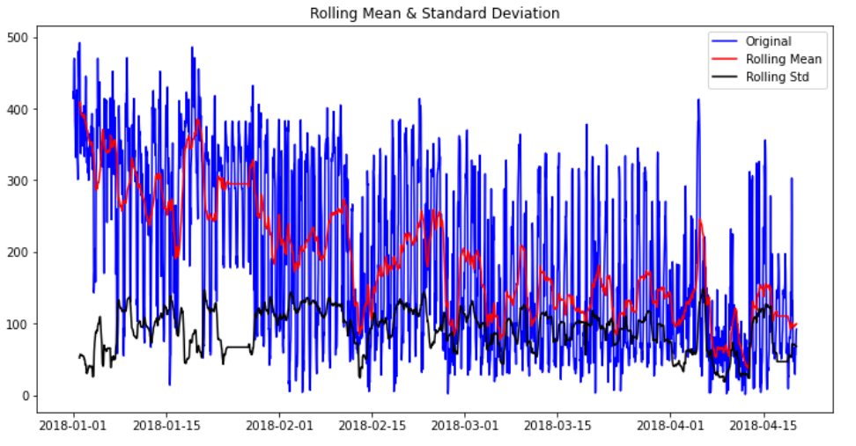
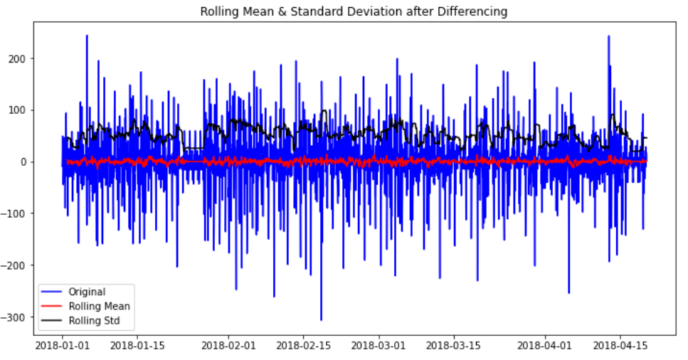
Rolling Mean and rolling Standard Deviation on original data.
Rolling Mean and rolling Standard Deviation on differenced data.

Slide 17
Augmented Dickey Fuller Test to identify stationarity of the data statistically.
ADF Test Statistic: : -15.458920116022599
P-Value : 2.7220291550048165e-28
#Lags Used : 26
No. of Observations Used : 2589
Strong evidence against null hypothesis(Ho), reject null hypothesis. Data is stationary

Slide 18
Model Building

Slide 19
Model - SARIMA
Grid Search to identify the best p, d, q values.
p = AR (Auto Regression) Order
d = Integration/Differencing Value
q = MA (Moving Average) Order
ARIMA Order | RMSE Score
(0,0,0) | 127.367804
(1,0,1) | 124.4302043
(4,1,4) | 118.8306406
(0,1,1) | 113.8217775
(0,1,2) | 113.5472463
(0,1,3) | 111.4671768
(0,1,4) | 110.6839062
(0,1,0) | 110.1114213
(3,0,3) | 106.9544771
(2,1,2) | 104.6660236
(2,1,3) | 104.3356504
(3,1,5) | 104.3061799
(3,1,4) | 103.9753595
(3,0,2) | 102.56611
(4,1,3) | 101.7104783
(2,1,5) | 101.3900724
(3,1,6) | 101.2029774
(2,1,6) | 99.06400476
(2,1,7) | 96.43425826
(2,1,8) | 96.14680155
(2,1,9) | 96.14680155
(3,1,9) | 95.75495992
(3,1,11) | 92.97409331
(0,1,5) | 89.01819641
(3,1,7) | 88.75139414
(3,1,8) | 88.1576289
(1,1,1) | 87.90740267
(4,1,2) | 87.79468548
(4,1,5) | 87.04188283
(2,1,4) | 84.95785116
(0,1,6) | 84.89720055
(2,1,1) | 84.70925409
(1,1,5) | 84.64261937
(1,1,6) | 84.60618537
(1,1,7) | 84.57177517
(3,1,2) | 84.51159219
(1,1,8) | 84.49980417
(1,1,9) | 84.49304681
(0,1,10) | 84.1757741
(4,1,1) | 84.16369354
(3,1,10) | 83.98577375
(2,1,10) | 83.77998773
(0,1,9) | 83.77441598
(0,1,8) | 83.5555517
(0,1,7) | 83.55505067
(1,1,10) | 83.45530452
The best p, d, q order identified as (1,1,10) and P, D, Q as (1,1,1) with seasonality period m = 24.

Slide 20
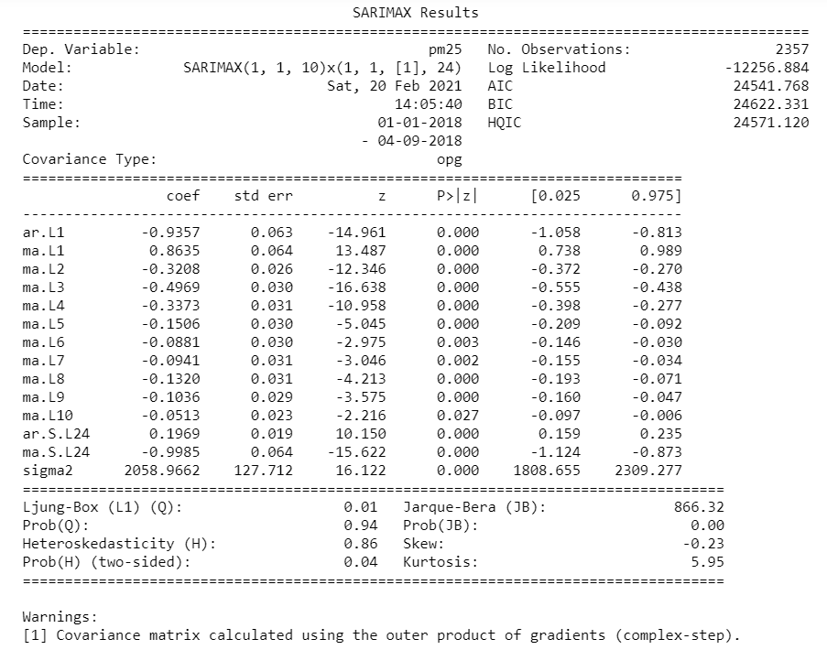
Model - SARIMA
We have built SARIMA (Seasonal ARIMA) model with same p, d, q values as in ARIMA i.e., (1,1,10) and we have identified the best (P,D,Q) values as (1,1,1) and m = 24.
SARIMA Model Summary

Slide 21
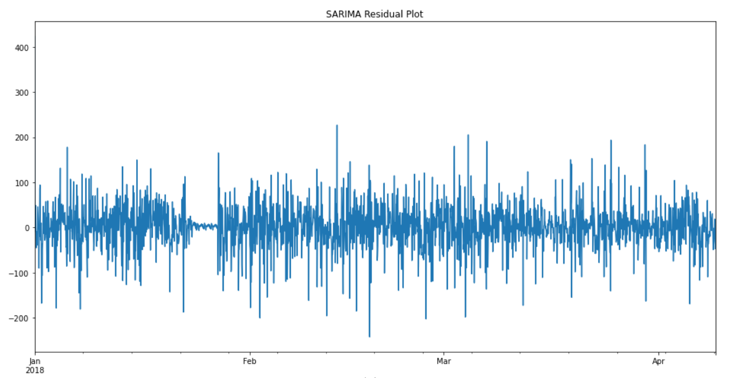
SARIMA Residual plot

Slide 22
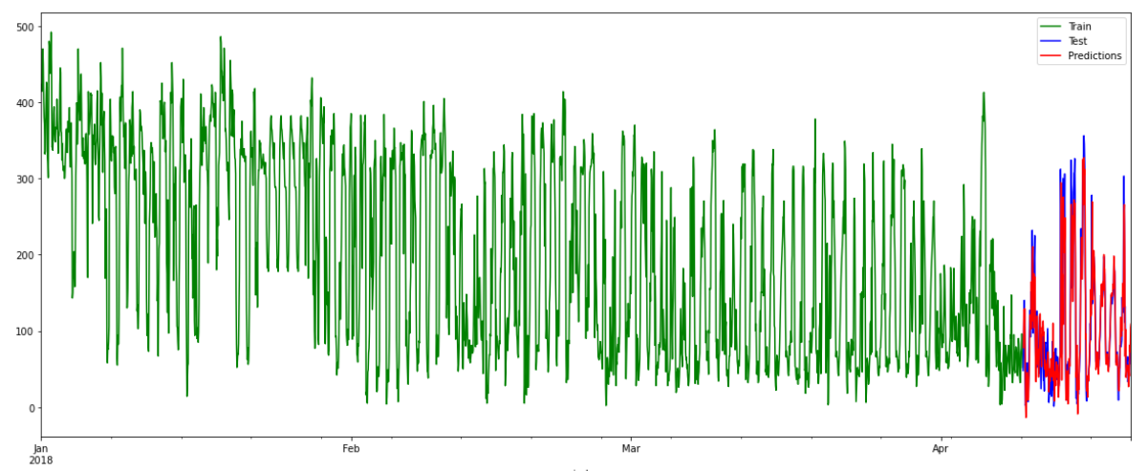
Final Model by combining both Train and Test Data.
RMSE: 73.310

Slide 23
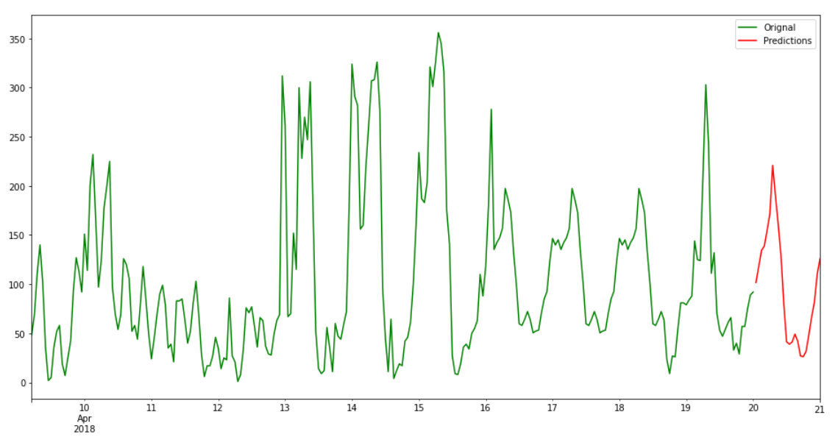
Visualizing Forecasted Values

Slide 24
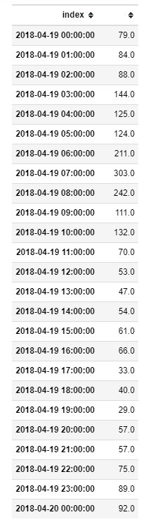
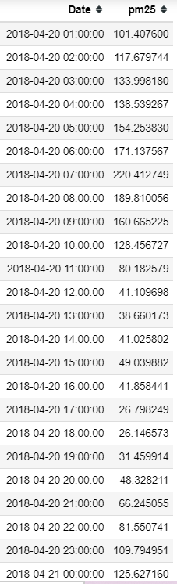
SARIMA Model Predictions
Last 24 Values of Dataset
Forecasted values for next 24 Hrs.

Slide 25
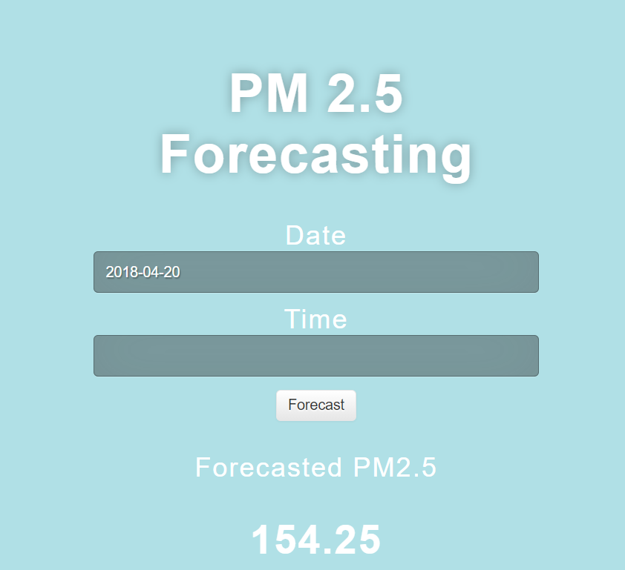
Model Deployment
Model deployment is done through Flask on Google Cloud Platform.

Slide 26
Challenges faced?
There were 243 dates missing in the dataset, for timeseries forecasting the data should be in a series.
Missing Values Imputation.
Deployment on Heroku platform.
How did you overcome?
Resampled the dataset to fill the missing dates.
As the values in the dataset are fluctuating more, we tried different imputation techniques, but there was no satisfactory results. Hence, finally we decided to go with month wise hourly mean imputation.
Model deployment on Heroku platform was a challenge, as we need to go through Github. Unfortunately in Github we can upload a file size of less than 25MB, but our Pickle file is around 1.3GB. So finally we decided to with Google Cloud Platform.

Slide 27
Thank you

